Slide 1


Arowwai Industries
ONLINE PC STORE WEBSITE
Presented by: Farras Haidar Pata & Javier Farel Baroto

Slide 2
ACKNOWLEDGEMENT
Thanks to Almighty God who has given the bless for finishing this Project (Information Search and Analysis Skill). Not forgetting thanks especially for the faculty of Mr. Reza Maulana, S.Kom.,M.Kom and other faculties who support us. Thank you also to fellow students who have supported. and thank you for being fellow workers in the education at CCIT-FTUI, and thank you for our family to help and support us to complete this assignment

Slide 3

CEP CCIT FTUI
INTRODUCTION

Slide 4
INTRODUCTION
Bootstrap
html
css
js
php

Slide 5
CEP CCIT FTUI
BOOTSTRAP

Slide 6
INTRODUCTION
Bootstrap is a popular front-end framework used to design responsive and modern web interfaces. It provides pre-designed templates, components, and utilities for layout, forms, buttons, navigation, and more.

Slide 7
CEP CCIT FTUI
HTML

Slide 8
INTRODUCTION
HTML is the standard language used for creating the structure of web pages. It consists of elements like headers, paragraphs, links, images, and forms, defining how content is organized.

Slide 9
CEP CCIT FTUI
CSS

Slide 10
INTRODUCTION
CSS is a stylesheet language used to define the visual presentation of HTML elements. It controls the layout, colors, fonts, spacing, and overall design of a webpage.

Slide 11
CEP CCIT FTUI
JAVASCRIPT

Slide 12
INTRODUCTION
JavaScript is a powerful scripting language used primarily to add interactive and dynamic features to websites. It enables developers to manipulate HTML elements, validate form data, create animations, and handle events.

Slide 13
CEP CCIT FTUI
PHP

Slide 14
INTRODUCTION
PHP is a server-side scripting language commonly used to develop dynamic websites and web applications. It can interact with databases, handle form submissions, manage sessions, and generate content dynamically.

Slide 15
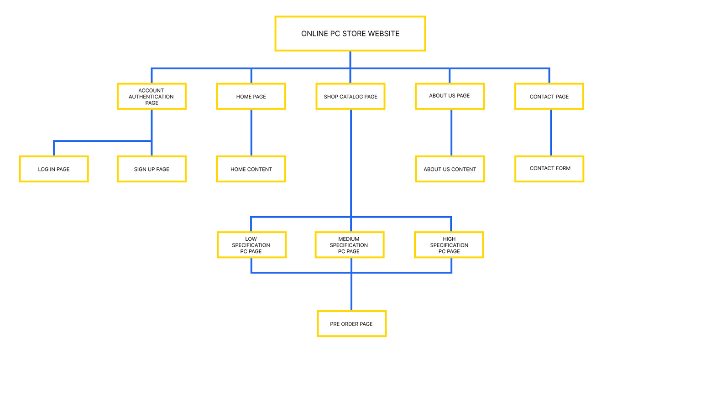
WEBSITE DIAGRAM

Slide 16
CEP CCIT FTUI
DO YOU HAVE ANY QUESTION?

Slide 17
CEP CCIT FTUI
THANK YOU FOR LISTENING TO OUR PRESENTATION

